Slide 1
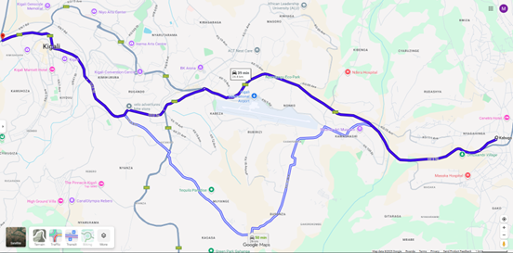
Data
Collection
Data Preprocessing
Featured Model
Model Evaluation
Pipeline Creation & Model Training
Mean Square Error
Data Standardization using StandardScaler
Data Split
Study Area
Training Dataset (75%)
Mean Absolute Error
Real Time Prediction
Root Mean Square Error
Machine Learning Models
5 fold-cross validation
Root Mean Square Percent Error
Testing Dataset (25%)
Deep Learning Algorithms
R-squared
Model Prediction
Real Time Sample Data

